Slide 1

연구/개발팀 ESP8266 시작하기
정 승 훈 차장

Slide 2
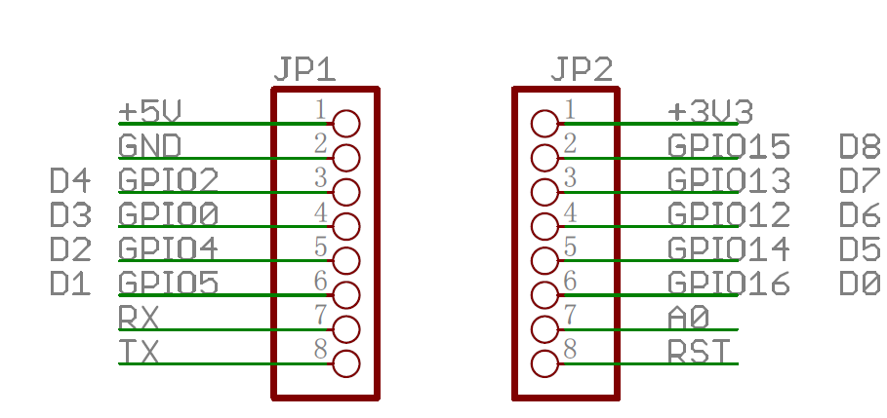
ESP8266
SSD1306
D5 -> CLK
D7 -> MOSI (DOUT)
D0 -> RES
D2 -> DC
D8 -> CS
SSD1306Spi display(D0, D2, D8);

Slide 3
개요
Adapter vs Controller
UART
ESP8266
STM32F

Slide 4
Adapter Mode
Adapter Mode
ESP8266
Firmware Downloader
MCU
Connector
Boot
Selector
Reset
Circuit
Status
Checker

Slide 5
HT20 vs HT40
차이
HT20 (High Throughput 20)은 20MHz 채널에서 작동하는 무선 장치를 의미합니다. 마찬가지로 HT40과 HT80은 각각 40MHz와 80MHz 채널을 사용합니다. 기본적으로 무선 장치는 20MHz 채널을 사용합니다. 속도를 향상시키기 위해 HT40은 2 개의 연속 20MHz 채널 또는 불연속 20MHz 채널을 바인딩하여 대역폭을 확장합니다. HT80은 4 개의 20MHz 채널을 결합하여 HT40보다 빠른 속도를 얻습니다. 802.11n 및 802.11ac는 모두 WLAN에서 사용할 20MHz 및 40MHz 채널을 제공 할 수 있습니다. 또한 802.11ac는 기술을 HT80으로 확장합니다.
802.11a / b / g 표준은 HT40 및 HT80을 지원하지 않으므로 HT40 및 HT80은 802.11b / g / n 혼합 모드와 같은 혼합 모드에서 사용할 수 없습니다.
2.4GHz 주파수 대역의 채널 분할로 인해 2.4GHz 대역에서 겹치지 않는 40MHz 채널을 하나만 설정할 수 있습니다. 따라서 HT40은 2.4GHz 대역에서 쉽게 영향을 받을 수 있습니다. HT20은 2.4GHz 주파수 대역에서 HT40보다 우수합니다. 겹치지 않는 20MHz 채널이 24 개 있습니다. 5GHz 대역에는 12 개의 40MHz 채널 또는 6 개의 80MHz 채널을 설정할 수 있습니다. 합리적인 채널 레이아웃을 위해 4 ~ 6 개의 채널을 사용하는 것이 좋으므로 HT40 및 HT80은 5GHz 대역에 적합합니다.

Slide 6
ESP8266
개요 1
Espressif’s ESP8266EX delivers highly integrated Wi-Fi SoC solution to meet users’ continuous demands for efficient power usage, compact design and reliable performance in the Internet of Things industry.
With the complete and self-contained Wi-Fi networking capabilities, ESP8266EX can perform either as a standalone application or as the slave to a host MCU. When ESP8266EX hosts the application, it promptly boots up from the flash. The integrated high speed cache helps to increase the system performance and optimize the system memory. Also, ESP8266EX can be applied to any microcontroller design as a Wi-Fi adaptor through SPI / SDIO or I2C / UART interfaces.
ESP8266EX integrates antenna switches, RF balun, power amplifier, low noise receive amplifier, filters and power management modules. The compact design minimizes the PCB size and requires minimal external circuitries.

Slide 7
ESP8266
개요 2
Besides the Wi-Fi functionalities, ESP8266EX also integrates an enhanced version of Tensilica’s L106 Diamond series 32-bit processor and on-chip SRAM. It can be interfaced with external sensors and other devices through the GPIOs. Software Development Kit (SDK) provides sample codes for various applications.
Espressif Systems’ Smart Connectivity Platform (ESCP) enables sophisticated features including fast switch between sleep and wakeup mode for energy-efficient purpose, adaptive radio biasing for low-power operation, advance signal processing, spur cancellation and radio co-existence mechanisms for common cellular, Bluetooth, DDR, LVDS, LCD interference mitigation.

Slide 8
ESP8266
Wi-Fi Protocols
802.11 b/g/n support
2 x Wi-Fi interface, supports infrastructure BSS Station mode / P2P mode / SoftAP mode support
Hardware accelerators for CCMP (CBC-MAC, counter mode), TKIP (MIC, RC4), WAPI (SMS4), WEP (RC4), CRC
802.11n support (2.4 GHz)
Supports MIMO 1×1 and 2×1, STBC, and 0.4 μs guard interval
WMM
UMA compliant and certified
Antenna diversity and selection (software managed hardware)
Configurable packet traffic arbitration (PTA) with dedicated slave processor based design provides flexible and exact timing Bluetooth co-existence support for a wide range of Bluetooth Chip vendor.
Dual and single antenna Bluetooth co-existence support with optional simultaneous receive (Wi-Fi/Bluetooth) capability

Slide 9
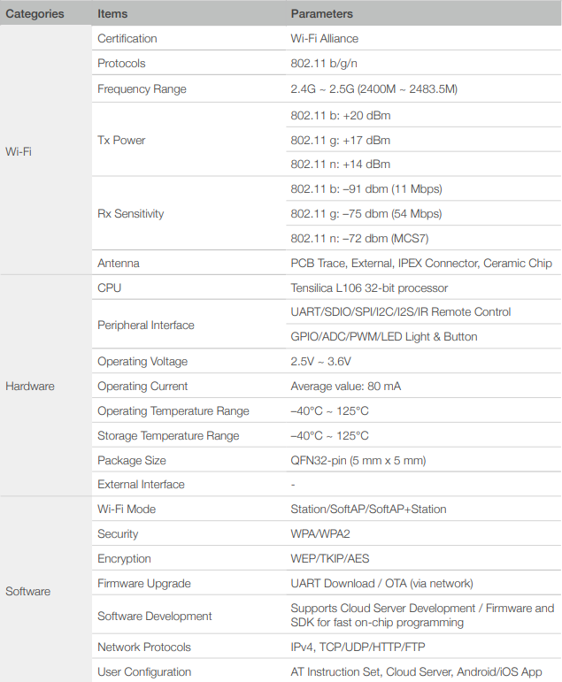
ESP8266
Specifications

Slide 10
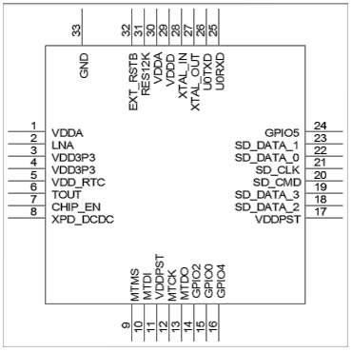
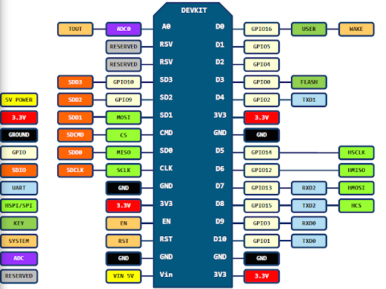
ESP8266
Pin Definitions

Slide 11
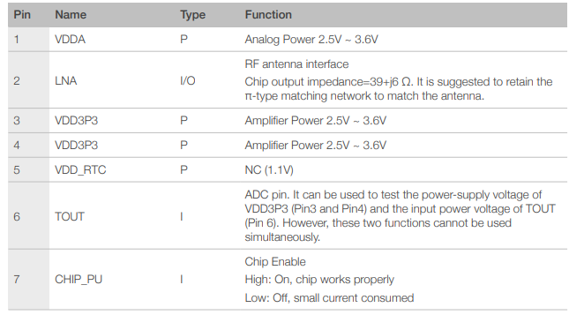
ESP8266
Pin Description 1

Slide 12
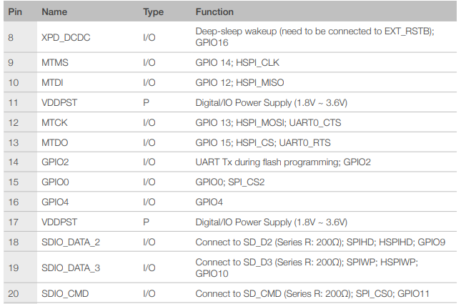
ESP8266
Pin Description 2

Slide 13
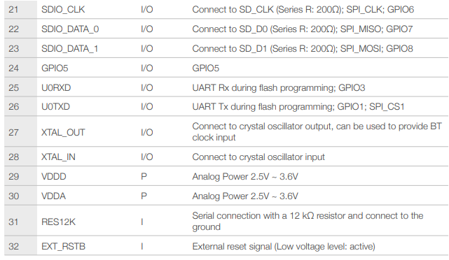
ESP8266
Pin Description 3

Slide 14
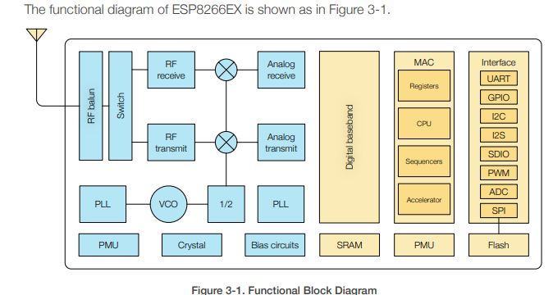
ESP8266
Functional Description

Slide 15
ESP8266
CPU
The ESP8266EX integrates a Tensilica L106 32-bit RISC processor, which achieves extralow power consumption and reaches a maximum clock speed of 160 MHz. The Real-Time Operating System (RTOS) and Wi-Fi stack allow 80% of the processing power to be available for user application programming and development. The CPU includes the interfaces as below.
Programmable RAM/ROM interfaces (iBus), which can be connected with memory controller, and can also be used to visit flash.
Data RAM interface (dBus), which can connected with memory controller.
AHB interface which can be used to visit the register

Slide 16
ESP8266
Memory
ESP8266EX Wi-Fi SoC integrates memory controller and memory units including SRAM and ROM. MCU can access the memory units through iBus, dBus, and AHB interfaces. All memory units can be accessed upon request, while a memory arbiter will decide the running sequence according to the time when these requests are received by the processor. According to our current version of SDK, SRAM space available to users is assigned as below.
RAM size < 50 kB, that is, when ESP8266EX is working under the Station mode and
connects to the router, programmable space accessible in heap + data section is around 50 kB.
There is no programmable ROM in the SoC, therefore, user program must be stored in an external SPI flash.

Slide 17
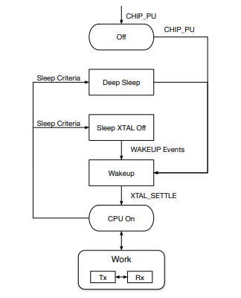
ESP8266
Power Management 1
ESP8266EX is designed with advanced power management technologies and intended for mobile devices, wearable electronics and the Internet of Things applications.
The low-power architecture operates in three modes: active mode, sleep mode and Deep sleep mode. ESP8266EX consumes about 20μA of power in Deep-sleep mode (with RTC clock still running) and less than 1.0 mA (DTIM=3) or less than 0.6 mA (DTIM=10) to stay connected to the access point.

Slide 18
ESP8266
Power Management 2
Off: CHIP_PU pin is low. The RTC is disabled. All registers are cleared.
Deep-sleep: Only RTC is powered on—the rest of the chip is powered off. Recovery memory of RTC can save basic Wi-Fi connection information.
Sleep: Only the RTC is operating. The crystal oscillator is disabled. Any wake-up events (MAC, host, RTC timer, external interrupts) will put the chip into the wakeup mode.
Wakeup: In this state, the system switches from the sleep states to the PWR mode. The crystal oscillator and PLLs are enabled.
On: The high speed clock is able to operate and sent to each block enabled by the clock control register. Lower level clock gating is implemented at the block level, including the CPU, which can be gated off using the WAITI instruction while the system is on.

Slide 19
ESP8266 – VS Code
프로젝트 생성 순서
Ctrl+Shift+P
Arduino: Initialize
RC522.ino
Board Manager
Board Config : ESP8266
Select Serial Port -> COM5
Arduino: Library Manager -> MFRC522
Arduino Upload
Arduino: Open Serial Monitor

Slide 20
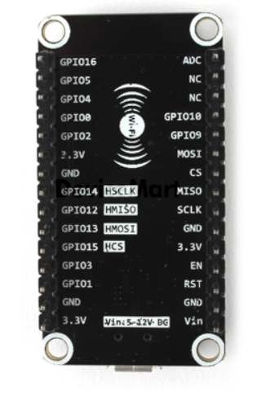
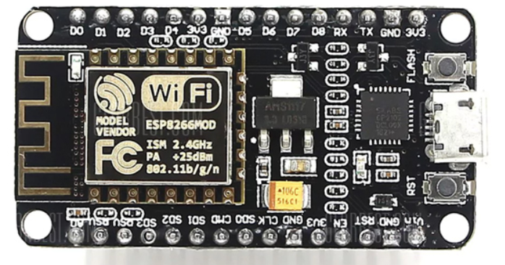
NodeMCU V2 ESP-12F WiFi (SZH-WFBB-017]

